Slide 1
Shell Programming

Slide 2
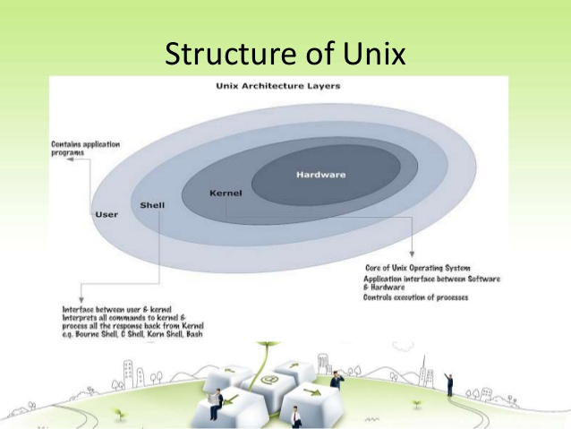

Slide 3
What is Shell ??
In an operating system, a shell is a program that acts as an interface between the user and the kernel (the core of the operating system).
It allows users to interact with the OS by typing commands, which are interpreted and sent to the kernel for execution.
Types of shells:
Command-line shells (CLI): These provide a text-based interface where users type commands to execute tasks.
  Bash (Bourne Again Shell), Zsh, and Fish.
Graphical shells (GUI): These provide a graphical interface, where users interact with the OS through windows, icons, and menus.
GNOME or KDE for Linux, or Windows Explorer on Windows.

Slide 4
Types of Shells (CLI) :
Bourne shell (sh)
C shell (csh)
TC shell (tcsh)
Korn shell (ksh)
Bourne Again SHell (bash)

Slide 5
Bash shell programming
Input
  prompting user
  command line arguments
Decision:
  if-then-else
  case
Repetition
  do-while, repeat-until
  for
  select
Functions

Slide 6
Simple Shell Scripts

Slide 7
#Example : echo command
Editor :
# This is a comment
# The “echo” command displays passed content on the screen
echo "Hello World !!”
Save it as :
Hello.sh
Run on the prompt as :
sh Hello.sh

Slide 8
#Example : $ Symbol
#Assignment statement
name="Alice”
#Display of a value on screen
#The $ symbol refers to value of a variable
echo "Hello, $name!"

Slide 9
#Example : read command
# read command is used to accept the user input
  echo “What is your name?”
  read MY_NAME
  echo "Hello $MY_NAME - hope you're well."
# read command to accept multiple inputs from the user
  echo "Enter your first name and last name:“
  read first_name last_name
  echo "Hello, $first_name $last_name!"

Slide 10
# read command is used to accept the user input in the same line of message
read -p "Enter your favorite color: " color
echo "Your favorite color is $color.“
Output:
    Enter your favorite color: Pink
    Your favorite color is Pink.

Slide 11
Shell Scripts with basic Linux commands
One of the primary purposes of shell scripting is to automate tasks by combining Linux commands with control structures like loops, conditionals, and functions.

Slide 12
#Example :
echo "The machine’s OS is"
echo uname
echo "The calander for this month is "
cal
echo "You are running these processes"
ps
Notes:
The C Shell
Copyright Department of Computer Science, Northern Illinois University, 2005

Slide 13
Output :
    the machine’s OS is
    Linux
    the calander for this month is
    January 2025
    Su Mo Tu We Th Fr Sa
    1 2 3 4
    5 6 7 8 9 10 11
    12 13 14 15 16 17 18
    19 20 21 22 23 24 25
    26 27 28 29 30 31
    You are running these processes
    PID TTY TIME CMD
    3258 pts/4 00:00:00 bash
    3651 pts/4 00:00:00 sh
    3654 pts/4 00:00:00 ps
Notes:
The C Shell
Copyright Department of Computer Science, Northern Illinois University, 2005

Slide 14
#Example :
# Display the current directory
echo “Current Directory:”
$ pwd
# List all files in the directory
echo “Files in the directory:”
ls -l

Slide 15
Shell Scripts with basic Control Structures

Slide 16
The simple if statement
if [ condition ]; then
statements
fi
executes the statements only if condition is true

Slide 17
The if-then-else statement
if [ condition ]; then
statements-1
else
statements-2
fi
executes statements-1 if condition is true
executes statements-2 if condition is false

Slide 18
The cascaded if…statement
if [ condition ]; then
statements
elif [ another condition ]; then
statement
else
statements
fi
The word elif stands for “else if”
It is part of the if statement and cannot be used by itself

Slide 19
Relational Operators
Meaning | Numeric | String
Greater than | -gt
Greater than or equal | -ge
Less than | -lt
Less than or equal | -le
Equal | -eg | = or ==
Not equal | -ne | !=
str1 is less than str2 |  | str1 < str2
str1 is greater str2 |  | str1 > str2
String length is greater than zero |  | -n str
String length is zero |  | -z str
CSCI 330 - The Unix System

Slide 20
Compound logical expressions
! not
&& and
|| or
and, or
must be enclosed within
[[ ]]

Slide 21
#Example :
echo "Enter a number:"
read num
if [ $num -gt 0 ]; then
echo "The number is positive."
elif [ $num -lt 0 ]; then
echo "The number is negative."
else
echo "The number is zero."
fi

Slide 22
#Example :
a=100
b=20
if [ $a -eq $b ];then
echo "a is equal to b"
elif [ $a -gt $b ];then
echo "a is greater than b"
elif [ $a -lt $b ];then
echo "a is less than b"
fi

Slide 23
#Example :
read -p "Enter age: " Years
if ["$Years" -lt 20 ]; then
echo "You can not Vote now."
else
echo "You can Vote now "
fi

Slide 24
#Example :
read -p "Enter calls handled:" CHandle
read -p "Enter calls closed: " CClose
if [ $CHandle -gt 150 ]||[ $CClose -gt 50 ];then
echo "You are entitled to a bonus"
else
echo "You get a bonus if the calls"
echo "handled exceeds 150 or"
echo "calls closed exceeds 50"
fi

Slide 25
#Example :
read -p "Enter Income Amount: " Income
read -p "Enter Expenses Amount: " Expense
let Net=$Income-$Expense
if [ "$Net" -eq "0" ]; then
echo "Income and Expenses are equal - breakeven."
elif [ "$Net" -gt "0" ]; then
echo "Profit of: " $Net
else
echo "Loss of: " $Net
fi

Slide 26
The while loop:
Syntax
while [ condition ]
do
code block
done
#while_ex.sh
count=1
while [ $count -le 5 ]
do
echo "Count: $count"
count=$((count + 1))
Done
Output:
Count: 1
Count: 2
Count: 3
Count: 4
Count: 5

Slide 27
Infinite loop:
while true
do
echo "This will run forever. Press Ctrl+C to stop."
done

Slide 28
break statement
count=1
while [ $count -le 10 ]
do
if [ $count -eq 6 ];
then
echo "Breaking the loop at count = $count“
break
fi
echo "Count: $count"
count=$((count + 1))
done

Slide 29
Pattern Example:
a=0
# this is loop1
while [ "$a" -lt 10 ]
do
b="$a"
# this is loop2
while [ "$b" -ge 0 ]
do
echo -n "$b “
b= $b - 1
done
echo
a= $a + 1
done
Output :
0
1 0
2 1 0
3 2 1 0
4 3 2 1 0
5 4 3 2 1 0
6 5 4 3 2 1 0
7 6 5 4 3 2 1 0
8 7 6 5 4 3 2 1 0
9 8 7 6 5 4 3 2 1 0

Slide 30
For loop with a list:
for variable in list
do
# commands to execute for each item in the list
done

Slide 31
Example:
for subject in OS DBMS AOA
do
echo "I like $subject"
Done
Output:
I like OS
I like DBMS
I like AOA

Slide 32
Example:
NUMS="1 2 3 4 5 6 7"
for NUM in $NUMS
do
Q=$((NUM % 2))
if [ $Q -eq 0 ];
then
echo “Even number!!"
continue
fi
echo “Odd number"
done
Output :
Odd number
Even number!!
Odd number
Even number!!
Odd number
Even number!!
Odd number

Slide 33
For loop with a range:
for i in {1..5}
do
echo "Number: $i "
Done
Output:
  Number: 1
  Number: 2
  Number: 3
  Number: 4
  Number: 5

Slide 34
Command-Line Arguments
The command-line arguments $1, $2, $3, ...$9 are positional parameters, with $0 pointing to the actual command, program, shell script, or function and $1, $2, $3, ...$9 as the arguments to the command.
Following script uses various special variables related to the command line −
echo "File Name: $0"
echo "First Parameter : $1"
echo "Second Parameter : $2"
echo "Quoted Values: $@“
echo "Quoted Values: $*"
echo "Total Number of Parameters : $#"

Slide 35
Where ….
  $0: The name of the script.
  $1, $2, $3, ...: The first, second, third, and subsequent command-line arguments.
  $#: The number of command-line arguments passed to the script.
  $@: All command-line arguments as separate quoted strings.
  $*: All command-line arguments as a single string.

Slide 36
Example :
echo "Today is:"
date
echo “No .of arg:”$#
echo “Program name:”$0
output:
[oss@pc021698 ~]$ sh today_1.sh
Today is:
Fri Mar 7 00:28:27 IST 2008
No .of arg:0
Program name: today_1.sh

Slide 37
Functions:
Example :
greet() {
echo "Hello, welcome to the shell scripting tutorial!"
}
# Calling the function
greet

Slide 38
Example:
disp()
{
echo “Hello World !!”
}
disp
Output : Hello World!!
Example:
disp()
{
echo "Hello"
}
i=0
while [ $i -lt 3 ]
do
disp
i=$((i+1))
Done
Output: Hello World!!
Hello World!!
Hello World!!

Slide 39
Passing Arguments to Functions:
Example:
sum()
{
((result = $1+$2))
echo $result
}
Ans = $(sum 10 5)
echo “The sum is : $Ans”
Output:
The sum is: 15
Notes:
Arguments can be passed to functions while calling it.
The function name can be followed by the argument that we want to pass.
The arguments passed to function are accessible inside the function through Positional Parameters

Slide 40
Program to add 2 numbers
#Read the first number
echo "Enter the first number:"
read num1
#Read the second number
echo "Enter the second number:"
read num2
# Perform addition
sum=$((num1 + num2))
#OR
# sum=$(($num1 + $num2))
# Display the result
echo "The sum of $num1 and $num2 is $sum"

Slide 41
2. Program to check if a number is even or odd
  echo "Enter a number:"
  read num
  if (( num % 2 == 0 ));
  then
  echo "$num is even."
  else
  echo "$num is odd."
  fi

Slide 42
3. Sum of n numbers
a=1
echo " enter n"
read n
s=0
while [ $a -le $n ]
do
s=$((s + a))
a=$((a + 1))
done
echo " SUM is " $s

Slide 43
4. Check if name is a file or directoy
echo "Enter the name"
read f
if test -f $f
then
echo "$f is a file"
elif test -d $f
then
echo "$ is a directory"
fi

Slide 44
5. displays all filenames beginning with a and displays its contents
for k in a*
do
echo "file name is $k"
cat $k
done

Slide 45
6 factorial of a number
echo " enter the number "
read n
f=1
i=1
while [ $i -le $n ]
do
f=$((f * i))
i=$((i+1))
done
echo "Factorial of $n is $f"

Slide 46
Display top 10 processes
echo "The top ten processes are :"
ps -e | head -n 10

Slide 47
Display processes with highest memory usage
echo "The top ten processes are :"
ps -eo pid,ppid,%mem,%cpu --sort=-%mem | head

Slide 48
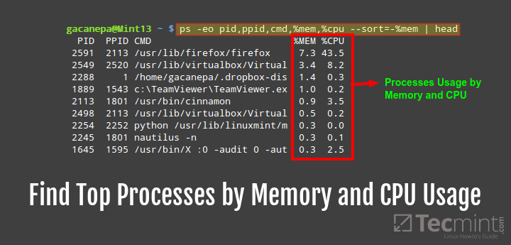
Notes:
Head-2

Slide 49
Display current logged in user
echo "Your username : $(echo $USER)"
echo "Current date and time : $(date)"
echo "Currently logged on users:"
who

Slide 50
Display Current Shell
echo $ SHELL
Display Home Directory
echo $ HOME
Display OS Type
uname -a

Slide 51
Display Current Working Directory
echo $ PWD
Notes:
PWd : Present Working Directory

